Slide 1
Lect1: Introduction to IoT and Integration of AI into IoT
Instructor : Eng. January
Area of Research Interest: Data Science, Artificial Intelligence, Internet of Things and Embedded systems

Slide 2
Presentation Agenda
What is Internet of Things?
How IoT Works?
Features of IoT
Advantages of IoT
Applications of IoT

Slide 3
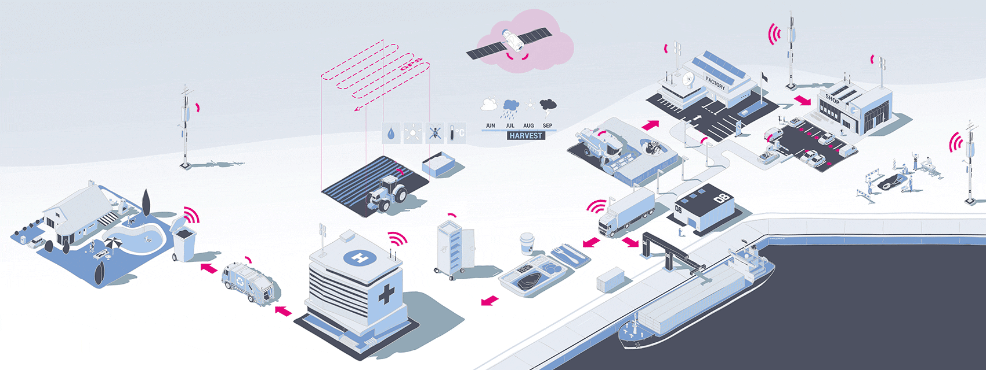
What is IoT?
Internet of Things (IoT) comprises things that have unique identities , connected to the Internet and can communicate and share information

Slide 4
Definitions?
The Internet of Things (IoT) is the network of physical objects or "things" embedded with electronics, software, sensors, and network connectivity, which enables these objects to collect and exchange data.
IoT allows objects to be sensed and controlled remotely across existing network infrastructure.

Slide 5
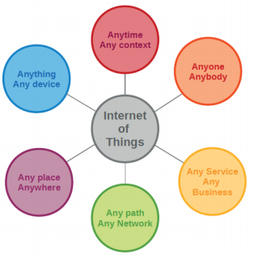

Slide 6
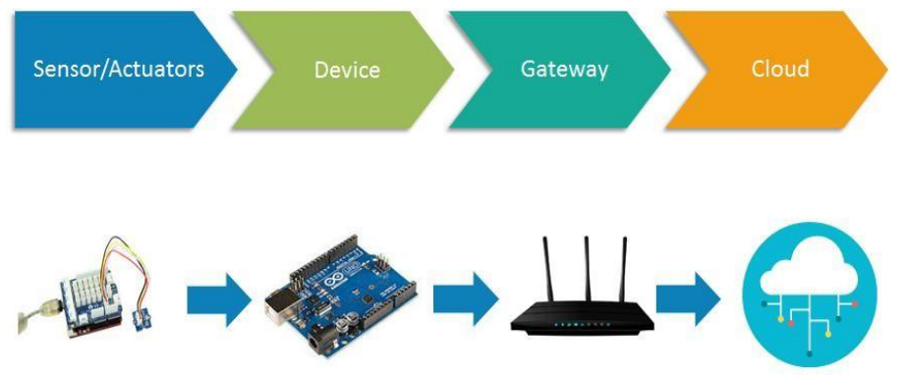
Basic components of an IoT System
IoT architecture consists of different layers of technologies supporting IoT.
There is no single consensus on architecture for IoT, which is agreed universally.
Different architectures have been proposed by different researchers.
IoT architecture varies from solution to solution, based on the type of solution which we intend to build.

Slide 7
How Internet of Things Works!

Slide 8
How internets of Things works
The entire working process of IoT starts with the device themselves, such as smartphones, digital watches, electronic appliances, which securely communicate with the IoT platform.
The platforms collect and analyze the data from all multiple devices and platforms and transfer the most valuable data with applications to devices

Slide 9
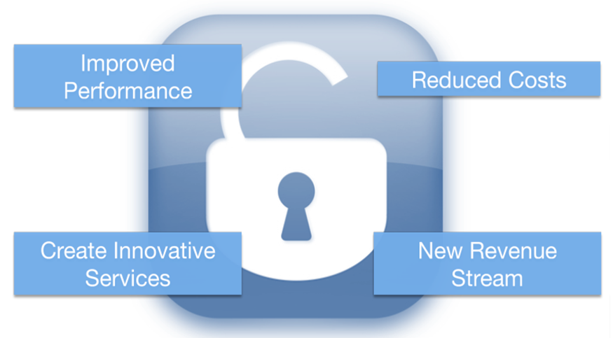
Potentials of IoT

Slide 10
IoT Enabling Technologies
Wireless Sensor Network(WSN)
Cloud Computing: Services are offered to users in forms of Infrastructure-as-a-service(IaaS), Platform-as-a-Service(PaaS), Software-as-a-Service(SaaS).
Big Data Analytics
Communication Protocols
Embedded Systems

Slide 11
IoT Applications

Slide 12
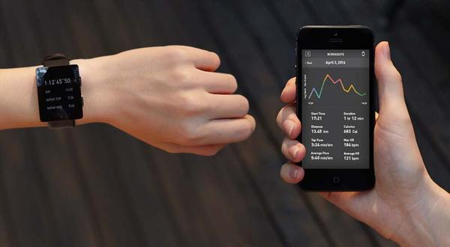
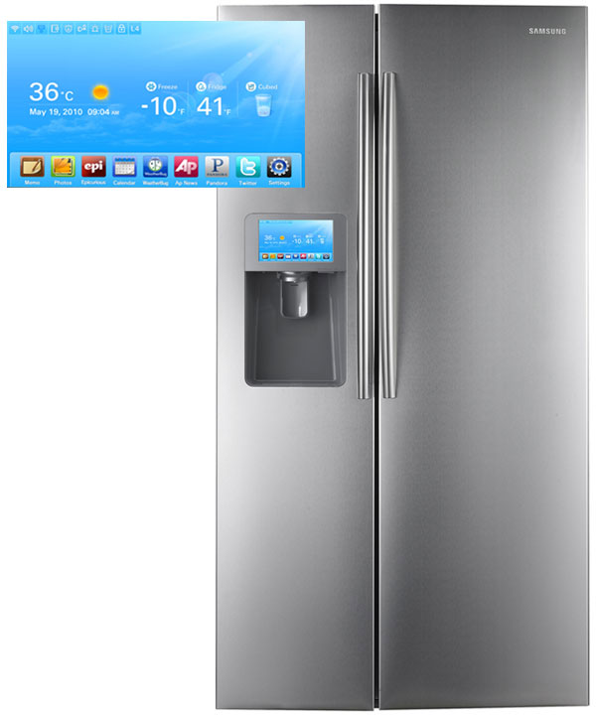
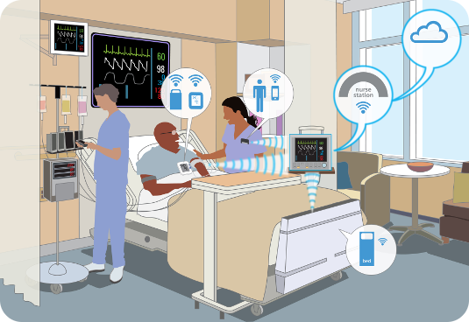
Information Security
Office of Budget and Finance
Education – Partnership – Solutions
Smart Appliances
Wearable Tech
Healthcare
Notes:
In our daily lives, we have become more reliant on IoT with our wearable tech, appliances, our cars, how we receive health care.

Slide 13
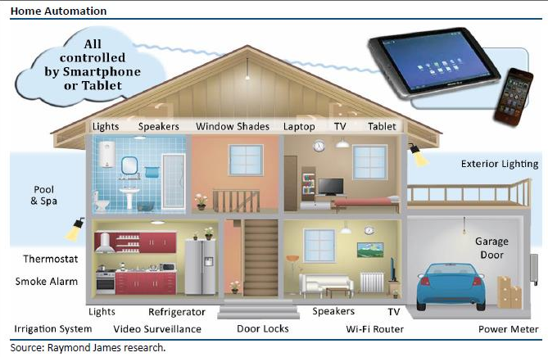
IoT Applications : Intelligent Home

Slide 14
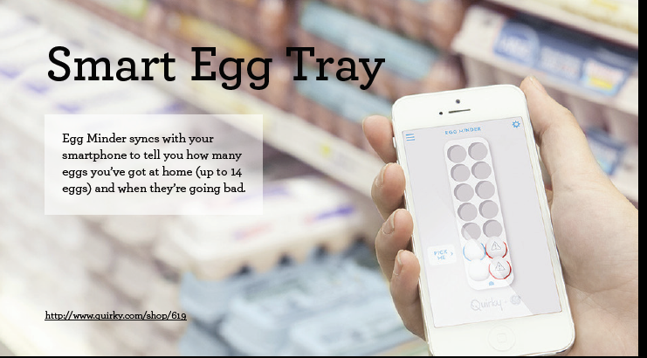

Slide 15
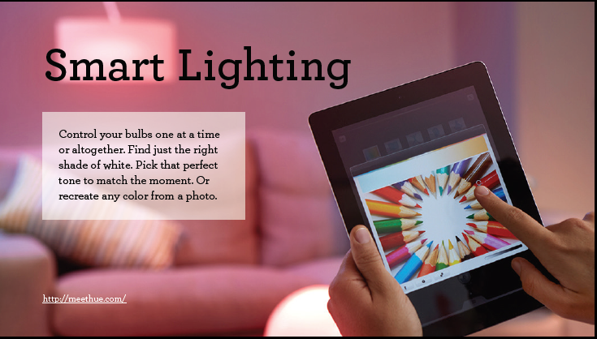

Slide 16
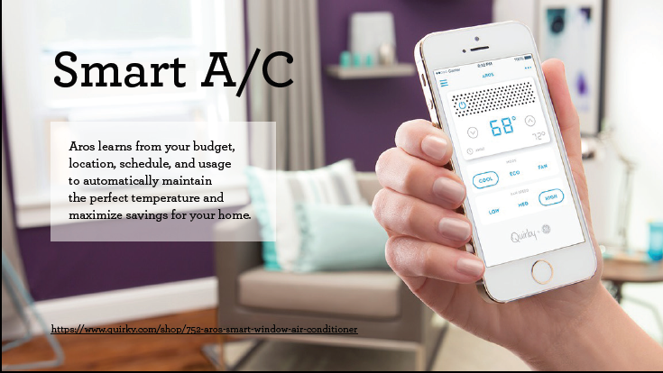

Slide 17
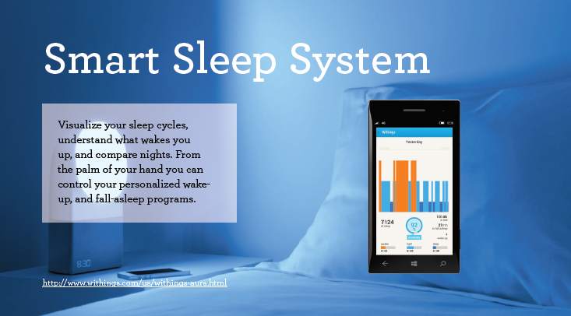

Slide 18
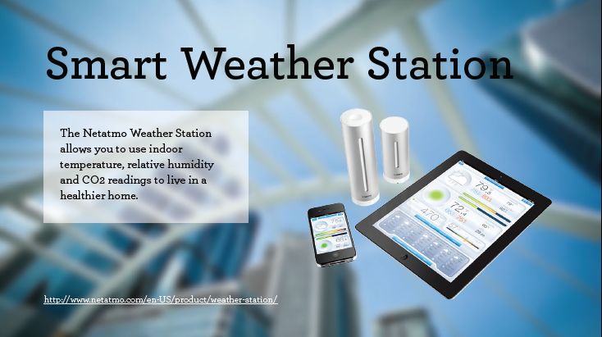

Slide 19
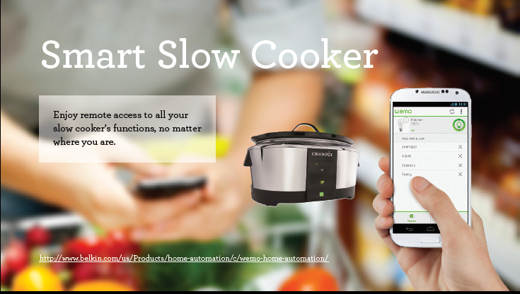

Slide 20
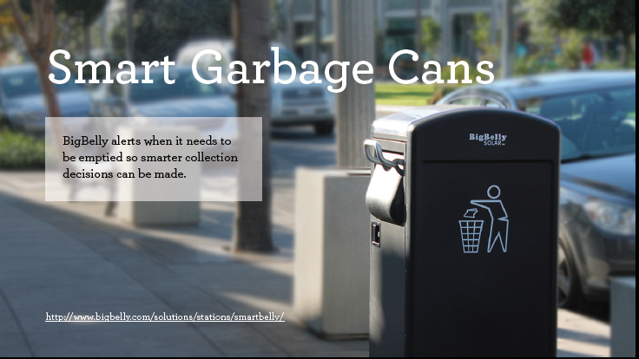

Slide 21
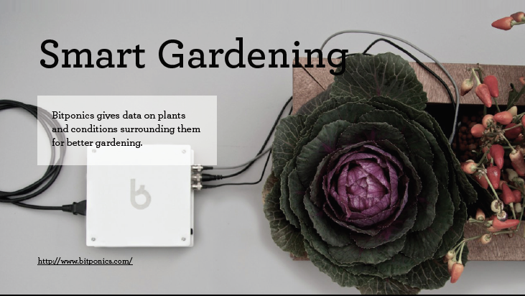

Slide 22
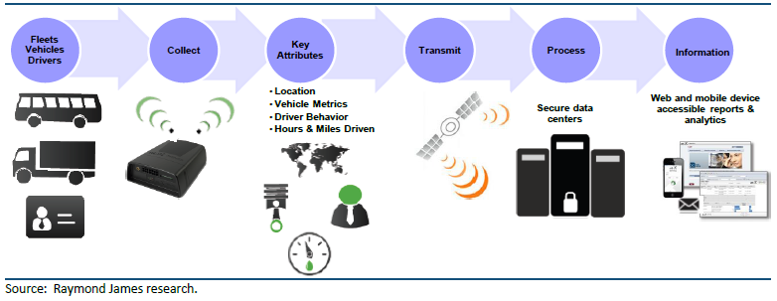
IoT Applications : Transportation

Slide 23
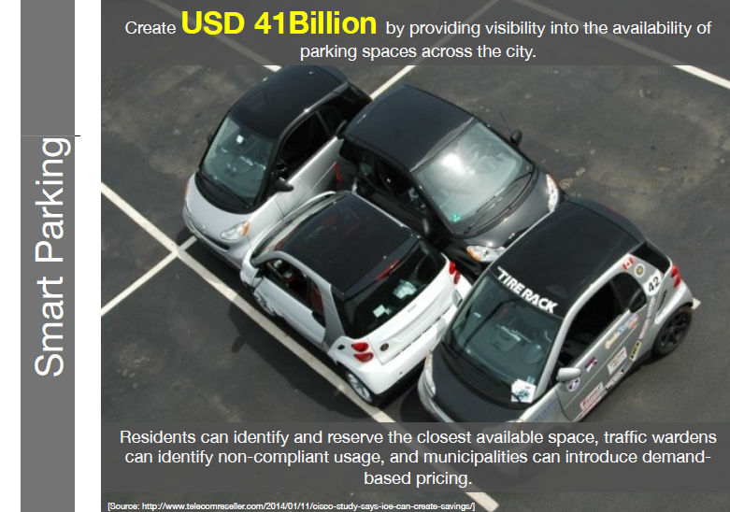

Slide 24
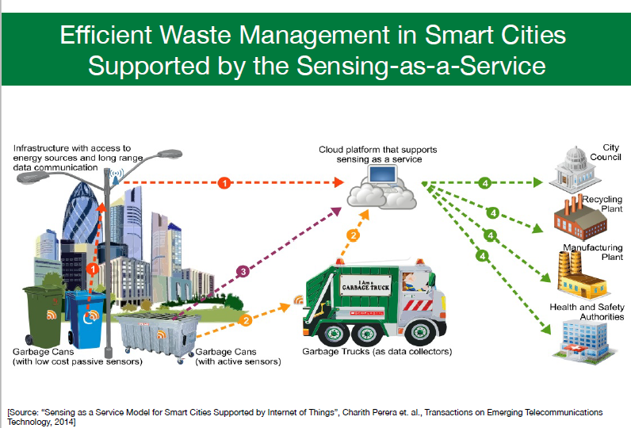

Slide 25
Sensors in even the holy cow!
In the world of IoT, even the cows will be connected and monitored. Sensors are implanted in the ears of cattle. This allows farmers to monitor cows’ health and track their movements, ensuring a healthier.

Slide 26
Integration of AI into Internet of Things
The internet of Things primary aims to collect data from physical devices or from environment.
It allows also those data collected to be accessed locally or remotely via any wireless communication environment such as Internet based network or GSM based communication network.
It allows also the operators to trigger actions on the fields remotely via internet connectivity.

Slide 27
Integration of AI into Internet of Things
The Sometimes the data collected by Internet of Things network can be useless to end customers unless they are interpreted by data analysis algorithms to draw new insights or information to the customers from raw data.
Therefore the AI provides the best data analytics algorithms to analyse the data from Internet of Things network to generate the new information to the general public.

Slide 28
References
Tracking the Evolution of the Internet of Things Concept Across Different Application Domains . Jorge E. Ibarra-Esquer 1,*, Félix F. González-Navarro 2, Brenda L. Flores-Rios 2, Larysa Burtseva 2 and María A. Astorga-Vargas 1
https://en.wikipedia.org/wiki/Internet_of_Things
Cisco whitepaper, "The Internet of Things" - How the Next Evolution of the Internet Is Changing Everything, by Dave Evans, April 2011.
GE cloud expo 2014, "Industrial Internet as a Service", by Shyam Varan Nath, Principal Architect.

Slide 29

Questions and Discussions
Thank you

